Slide 1

Database Systems
Database Systems

Slide 2
Common Definitions
Database System
Data, Processing & Information
The Role of Data in Business
Meta Data& Metameta Data
What is a Database
Evolution of databases
Types of files
Traditional File Processing Systems
Types of DBMS

Slide 3
Todays Objective
Database System
Today we will learn:
Some common uses of database systems
The characteristics of file-based systems
The problem with the file-based approach
The meaning of the term ‘Database’
The meaning of the term Database Management System’ (DBMS)
The typical functions of DBMS
The major components of the DBMS environment
The advantages and disadvantages of DBMSs

Slide 4
Introduction
Definitions
Data:
“A collection of raw facts and figures”.
“Data consists of facts, text, graphics,
images,sound and video.”

Slide 5
Figure 1-1a Data in Context

Slide 6
Information:
Data processed to be useful in decision making.
Information is, processed data that is correlated and meaningful.

Slide 7
Figure 1-1b Summarized data

Slide 8
Metadata: Data that describes data.
Example
Name Type Length Min Max Description
sId Character 11 11 11 Student Id
cId Character 8 8 8 Course Id
Section Integer 1 1 9 Section Number
Year Integer 4 1980 2100 Year Completed
Term Integer 4 1 4 Semester
Grade Character 1 Alpha Grade: Must be in (A,B,C,D,F,I)

Slide 9
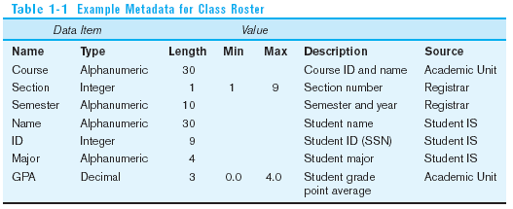
Descriptions of the properties or characteristics of the data, including data types, field sizes, allowable values, and data context

Slide 10
MetaMeta Data
“Data about a metadata record”
Information about a metadata record, such as when that record was created, by whom, and when it was last updated, is called metametadata

Slide 11
Data Vs Information
Data are….. | Information is….
1.Stored facts | 1. Presented facts
2.Inactive (They exist) | 2.Active (It enables doing)
3.Technology –based | 3.Business Based
4.Gathered from various sources | 4.Transformed from data
5.Refers to the values actually stored in. | 5. Refers the meaning of the values as understood by some users

Slide 12
Types of Files
Master File
“A master file is a relatively permanent file relating to a standard. The records changes less frequently. “
Example:Customers, student’s, employee’s
Table File
“A table file contains references data used by information system.These are relatively permanent. Updated by periodically.”
Example: Tax table, postage rate tables, department code file
Transaction File:
It contains records reflect day-to-day activities.These are temporarily files.
Example: New employees, patient release, cash receipt, commission and customer payments

Slide 13
Security File
“Is a file that is created and saved for backup and recovery purposes. New security files must be created periodically to replace old, outdated security files.”
History File
“Is a file created and saved historical reasons. Don’t replace old files; usually both the old and new history files are saved.”

Slide 14
What is File Processing Systems
File: a collection of related information defined by its creator.
Physical file: a file actually exists in a storage devise.
( a collection of bites, as seen by the operating system.)
Logical file: a file viewed by users and programs.
( a collection of records.)
A file management system, usually within the operating system, is
used to efficiently access physical files stored in the secondary storage
devices.
Functions: create, updates, retrieval
Examples: Hard copy registers/folders,bill folder, tax folder

Slide 15
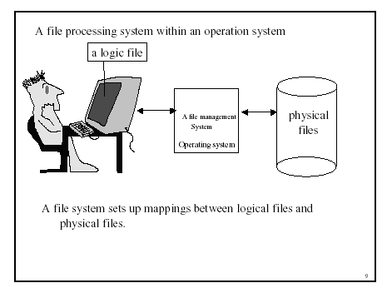

Slide 16
Databases
Web indexes
Library catalogues
Medical records
Bank accounts
Stock control
Personnel systems
Product catalogues
Telephone directories
Train timetable
Airline bookings
Credit card details
Student records
Customer histories
Stock market prices
And so on….

Slide 17
Some common uses of database systems
Purchase from the U-mart
Cash withdrawal from ATM (of The Bank of Punjab, Fowara Chowk, Gujrat)
Purchase using your credit card
Registration at NADRA office
Using the internet
University of Gujrat Information System (UOGIS)
HELP

Slide 18
File-based systems
A collection of programs that perform services for the end-user.
Database Systems

Slide 19
The Characteristics of file-based systems
Library
Examination
Registration
Library
Applications
Examination
Applications
Registration
Applications
Library
Data
Files
Examination
Data
Files
Registration
Data
Files

Slide 20
The Problems with File-Based systems
The Limitations of the file-based approach
Separation and isolation of data
Duplicate of data
Data dependence
Incompatible file formats

Slide 21
The Problems with File-Based systems
Library
Examination
Registration
Reg_Number
Reg_Number
Reg_Number
Name
Name
Name
Father Name
Address
Father Name
Books Issued
Class
Phone
Fine
Semester
Address
Grade
Class

Slide 22
The meaning of the term “Database Management System DBMS”
-A software system that enables users to define, create, and maintain the database and that provides controlled access to this database.
A database management system (DBMS) is computer software that manages databases.
Examples: Oracle, SQL Server, Informix, Sybase, Ingress

Slide 23
The meaning of the term “Database Management System DBMS”
Application
#1
Application
#2
DBMS
Database
containing
centralized
shared data
Database Systems
Application
#3

Slide 24
The meaning of the term “Database”
-Shared collection of logically related data (and a description of this data), designed to meet the information needs of an organization.
Database Systems

Slide 25
The meaning of the term “Database”
Shared collection – can be used simultaneously by many departments and users.
Logically related - comprises the important objects and the relationships between these objects.
Description of the data – the system catalog (meta-data) provides description of data.

Slide 26
Database
Database Systems
Database | A collection of related files
^
File | A collection of records about a particular set of people, objects, entities and so on
^
Record | A collection of related fields associated with a single person, object, entity and so on
^
Field | A collection of bytes representing a single attribute.
^
Byte | A collection of bits representing a single character
^
Bit | A binary digit

Slide 27
Database
A database is a collection of integrated files.
Integrated : Collection of files.
Note: A FILE is a collection of logical records in a tabular format.
A RECORD contains fields (or attributes ) about the entity.
A field is same as an ‘attribute’

Slide 28

Advantages of Database Approach
Library
Examination
Registration
Library
Applications
Examination
Applications
Registration
Applications
Database
Management
System
- Data Sharing
University
Students
Database
- Data Independence
- Controlled Redundancy
- Better Data Integrity

Slide 29
Advantages of Database Approach
Database Systems
Data Sharing
Data Independence
Controlled Redundancy
Better data Integrity
Data consistency
Better data security
Faster development of new applications
Economy of scale
Better concurrency
Better backup procedures

Slide 30
Two-Tier Client-Server
Client manages main business and data processing logic and user interface.
Server manages and controls access to database.

Slide 31
The advantages and disadvantages of DBMSs
Higher costs (DBMS)
Conversion cost (manual to computerized )
More difficult recovery
Database Systems

